Slide 1

SUDOKU GAME
A Puzzle

Slide 2
Presented by-
MD YEASIN ARAFAT
ID: 211002121
SEC: D5
BATCH: 211

Slide 3
Table of contents
Features & Objectives
Rules of this game
Using tools
Source Code
Output/Result
Conclusion

Slide 4
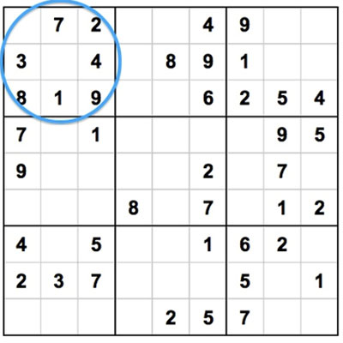
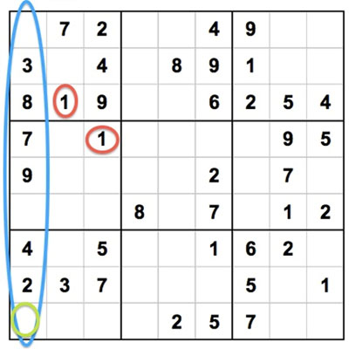
Features & objectives
Use Numbers 1-9
Don’t Repeat Any Numbers
Don’t Guess
Use Process of Elimination

Slide 5
Rules & regulations
Sudoku grid consists of 9x9 spaces.
You can use only numbers from 1 to 9.
Each 3×3 block can only contain numbers from 1 to 9.
Each vertical column can only contain numbers from 1 to 9.
Each horizontal row can only contain numbers from 1 to 9.
Each number in the 3×3 block, vertical column or horizontal row can be used only once.
The game is over when the whole Sudoku grid is correctly filled with numbers.

Slide 6
Using tools
PROJECT PLATFORM:
C/C++
PROGRAMMING LANGUAGE USED:
C Programming Language
PROJECT TYPE:
Desktop Application
IDE TOOL:
Codeblocks

Slide 7
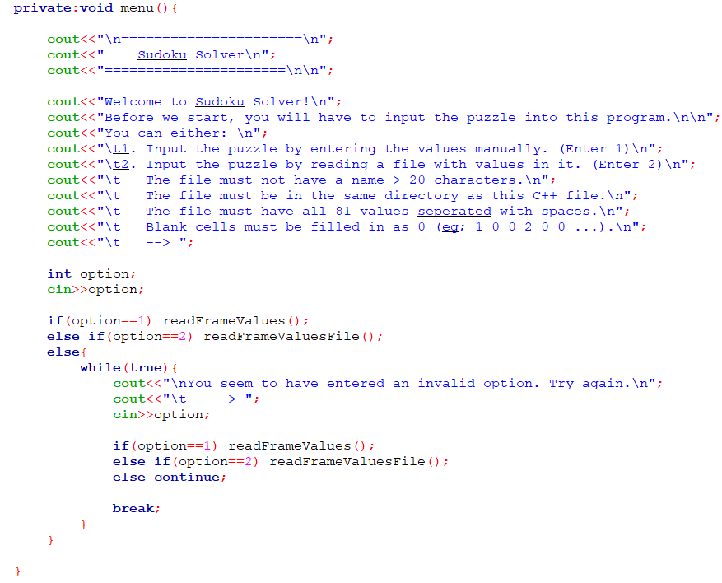
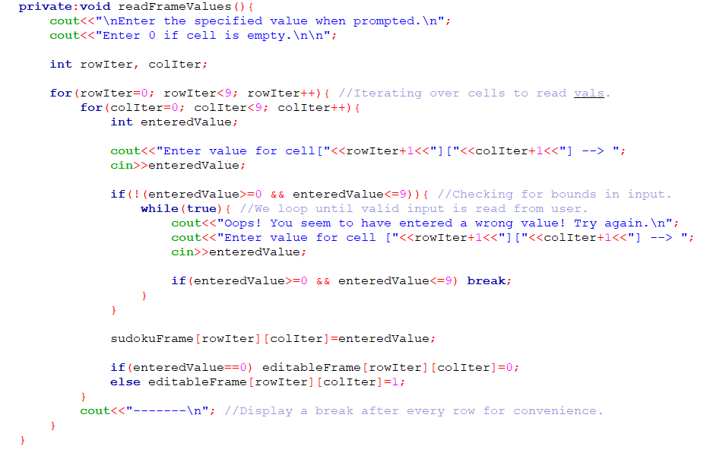
Source code
For taking input values
For ‘Menu’ module-

Slide 8
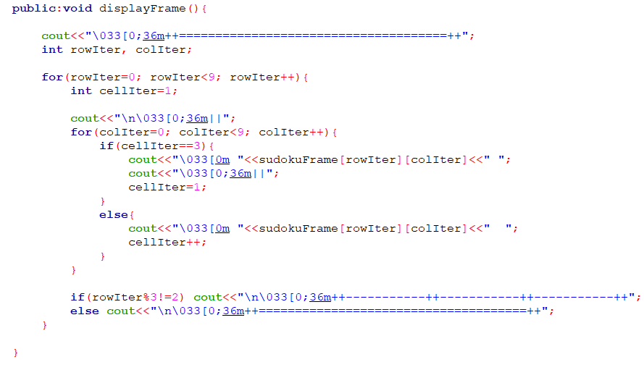
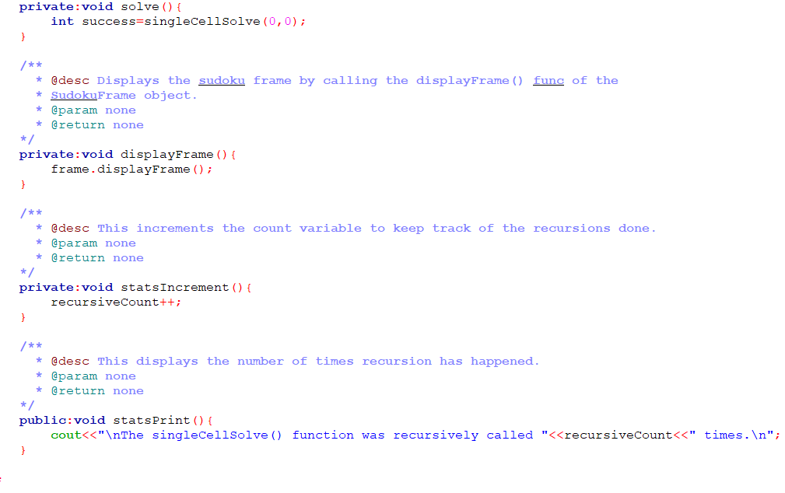
For displaying values module-
For solving module-

Slide 9
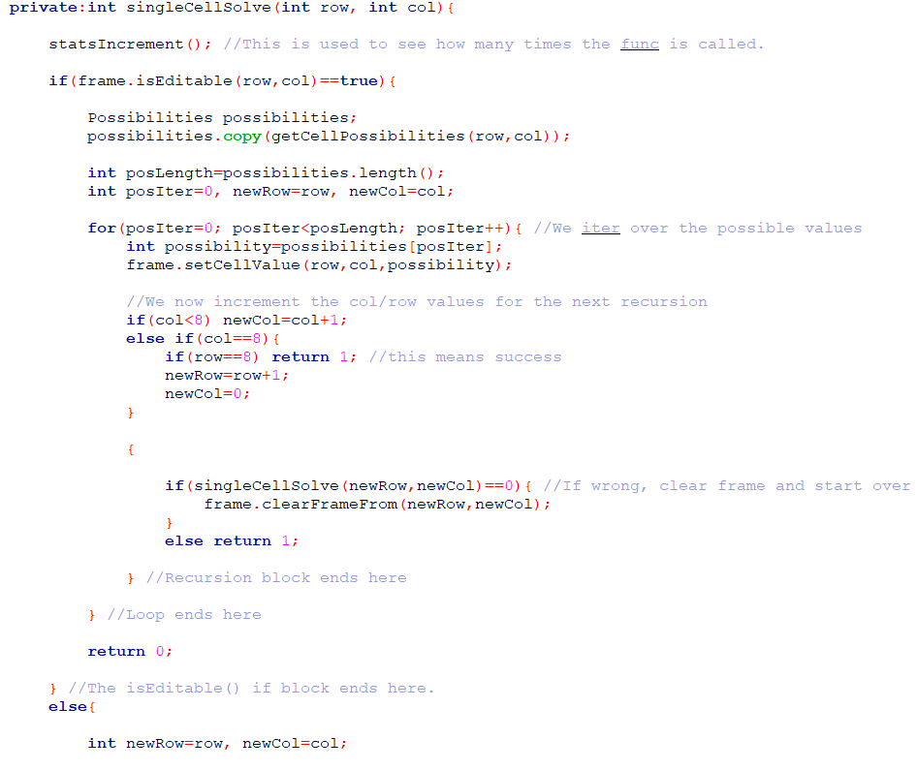
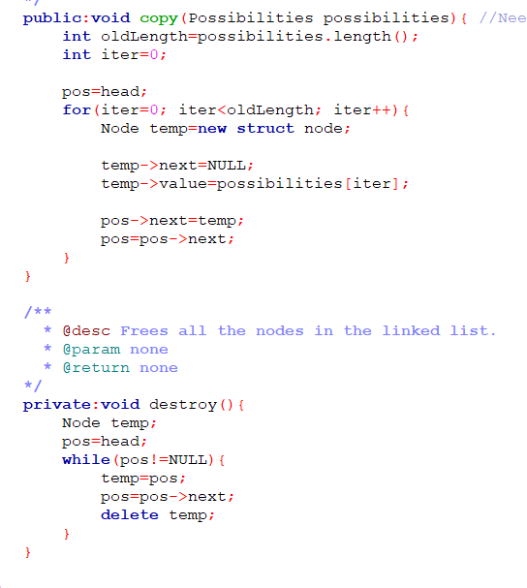
For solving inputs module-
Next value & Node module-

Slide 10
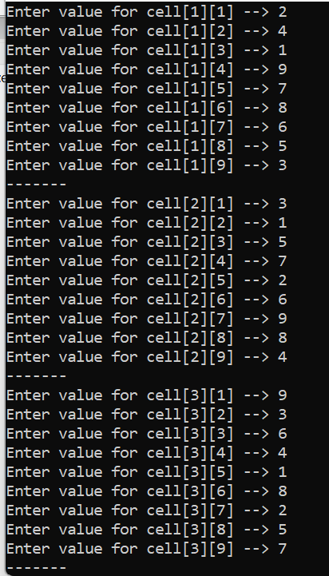
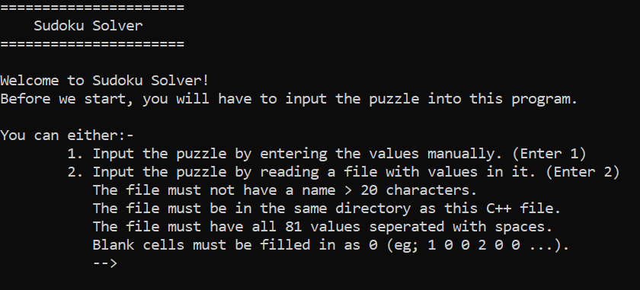
Output/Result

Slide 11
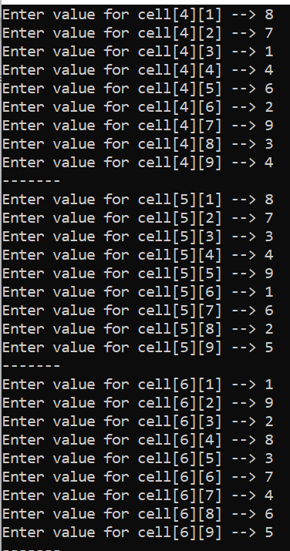
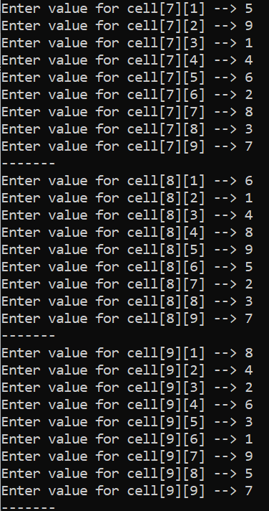
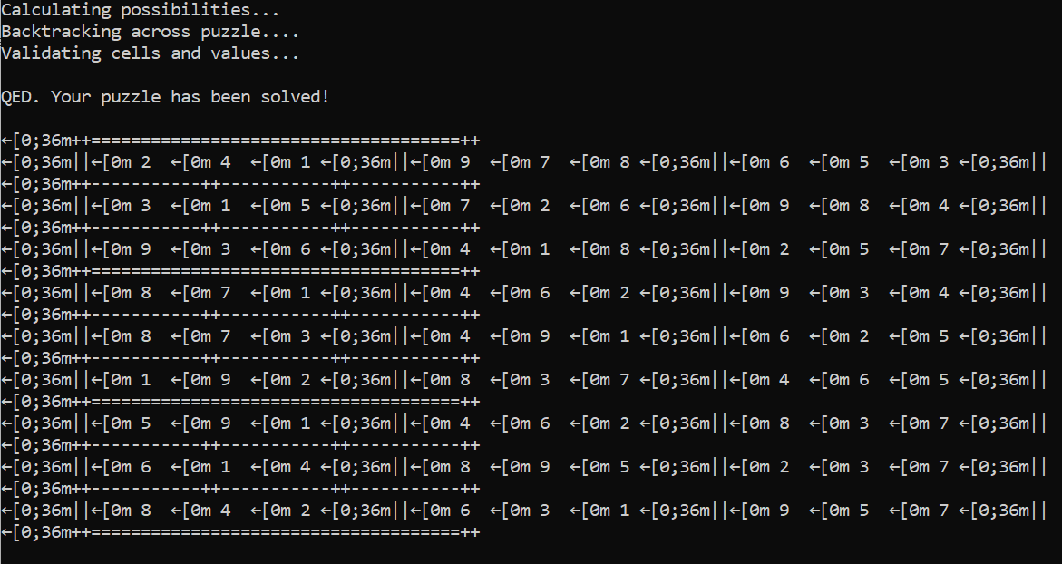
Output/Result

Slide 12
conclusion
We have now defeated Sudoku through the use of Constraints and some simple Backtracking Search. During the process we took a few pointers from how normal people go about solving these problems, and were able to improve our algorithms by studying these actual intelligences.
Hopefully you've learned something interesting about Constraint Satisfaction Problems, Artificial Intelligence, Sudoku, or at least how not to write a presentation. It has been fun.

